Slide 1

Applied DevOps
by: Usaid Rehan, Umer, Mukand Rathi

Slide 2



1. The Repositories
We used 2 Different Repositories:
Portfolio Website
NodeJs Calculator Application

Slide 3
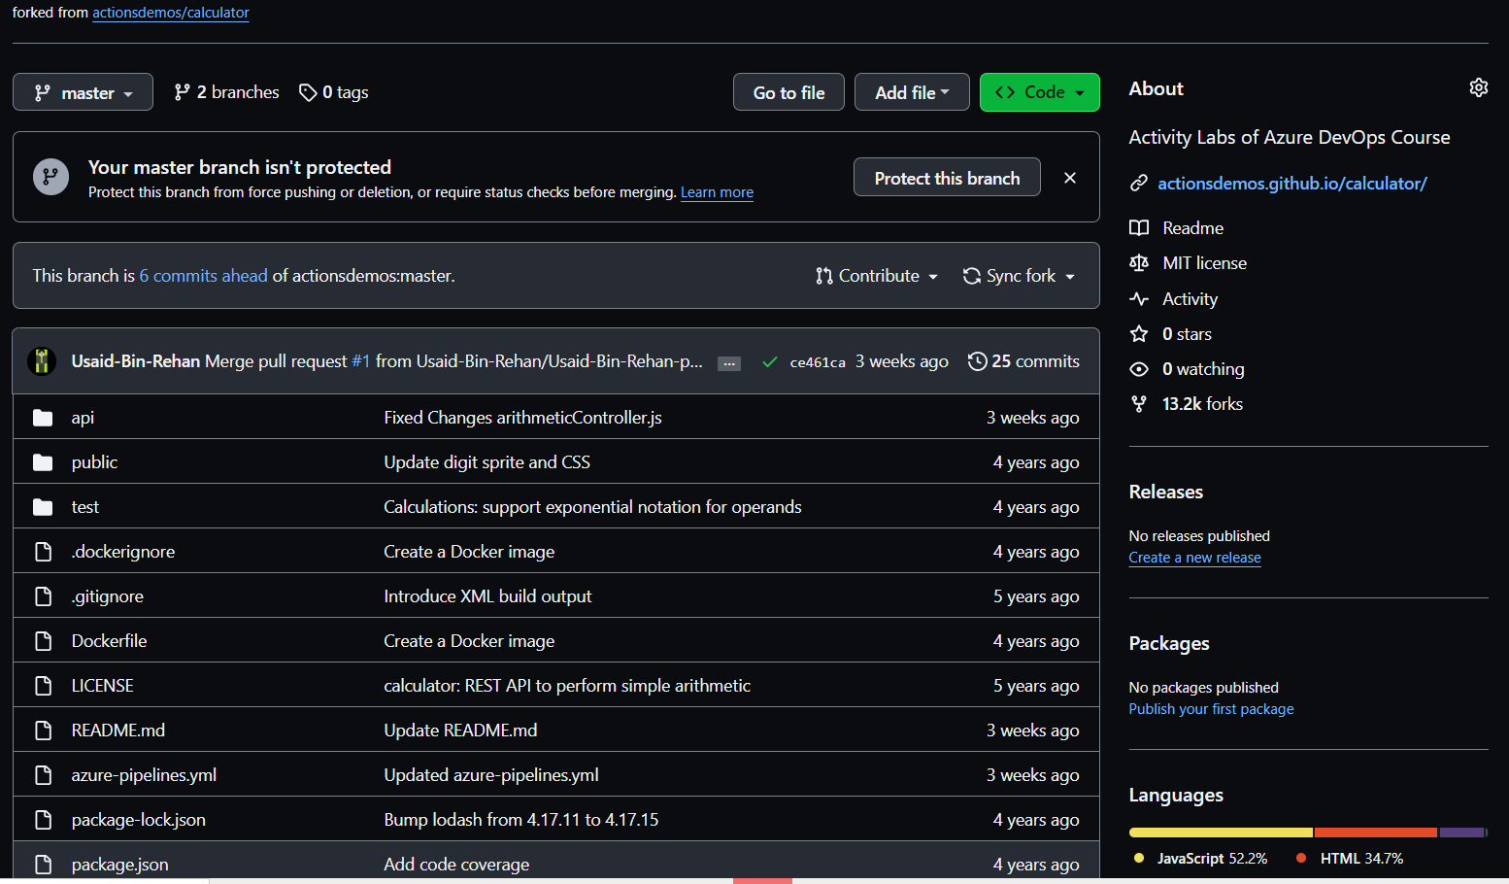

Slide 4
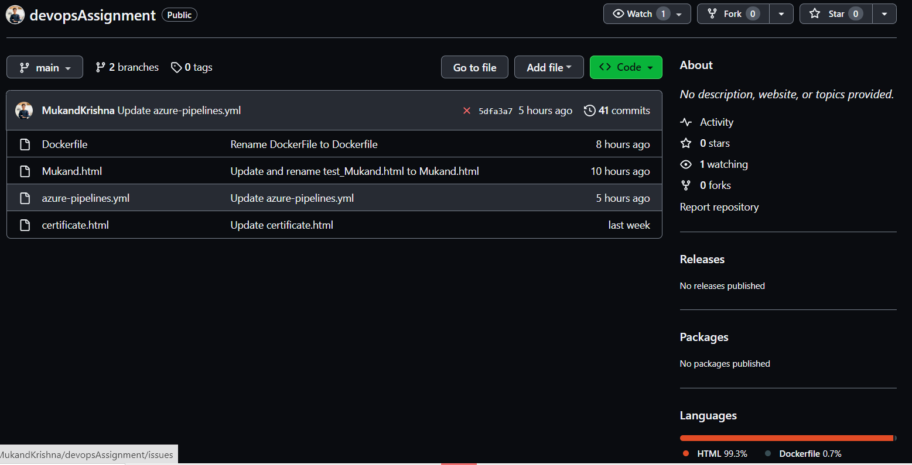

Slide 5
2. The CI Pipeline
We created build pipelines for that perform following:
Automated Testing
Containerization

Slide 6
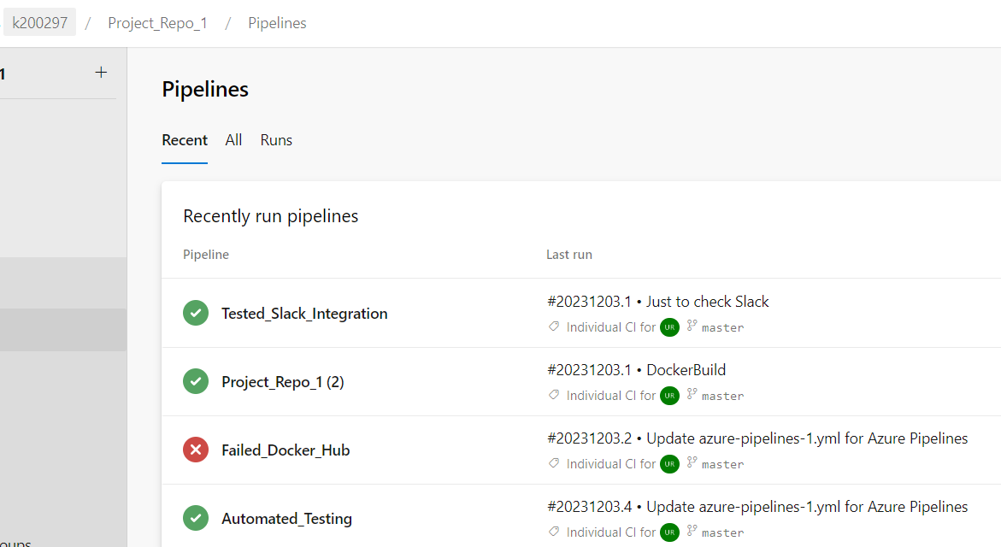

Slide 7
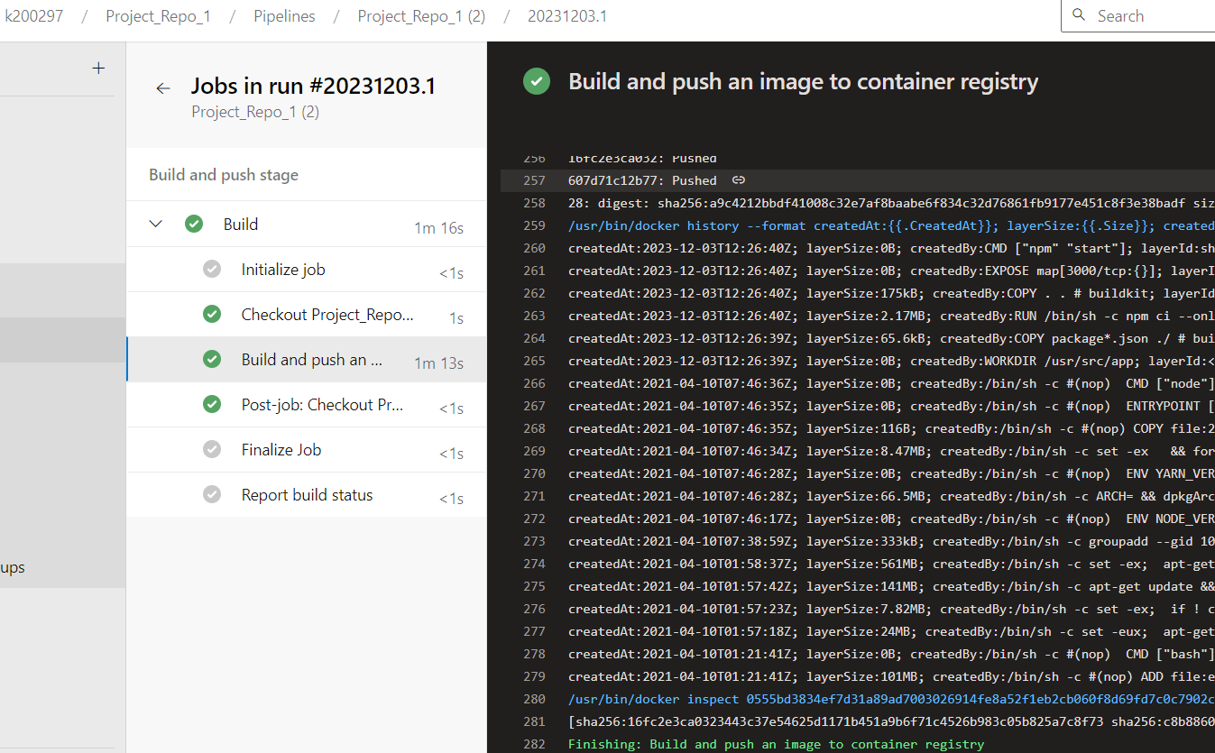

Slide 8
3. Unit Testing
We created the following 5 Test Cases for the Calculator app:
Rejection of Division by Zero
Addition of Two Negative Floating Point Numbers
Multiplication of Zero with Any Number
Subtraction of a Negative Number from Positive Number
Multiplication of Supporting Negative Exponent

Slide 9
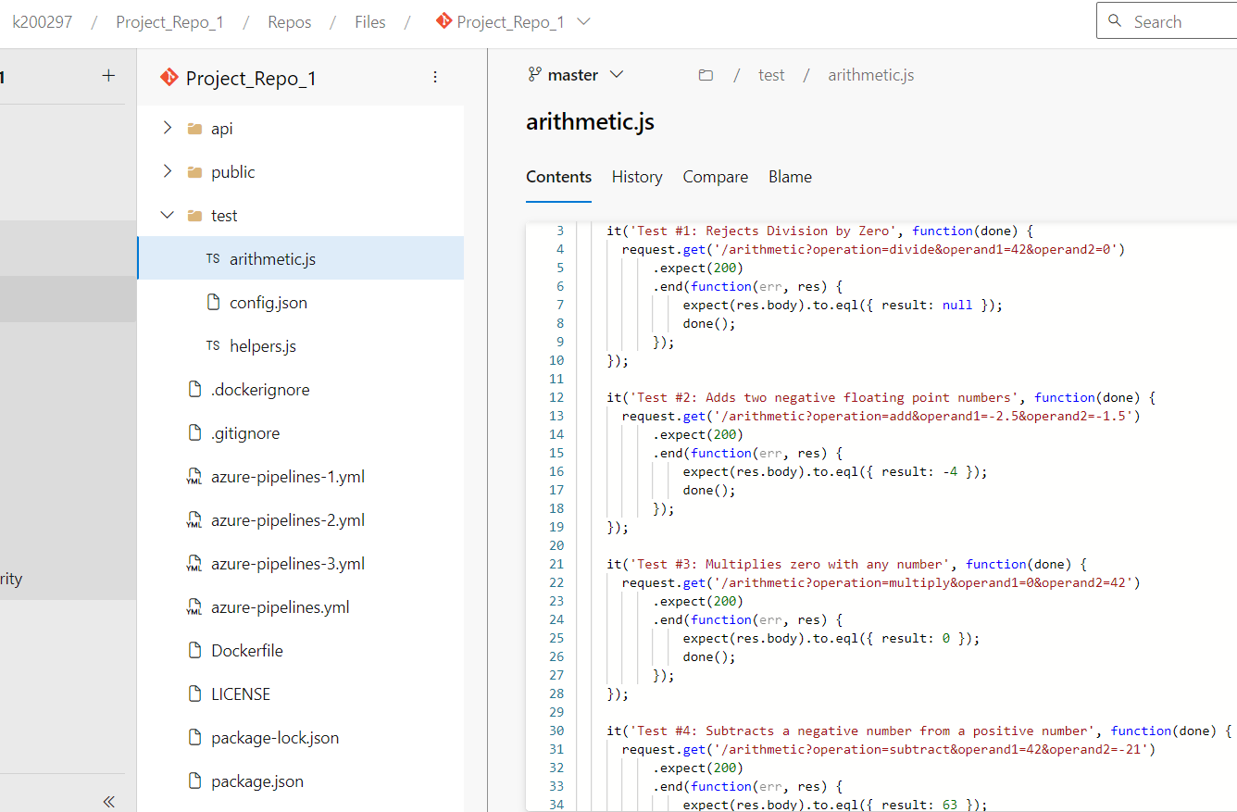

Slide 10
4. Automated Testing Scripts
We automated testing of the Calculator using build pipeline

Slide 11
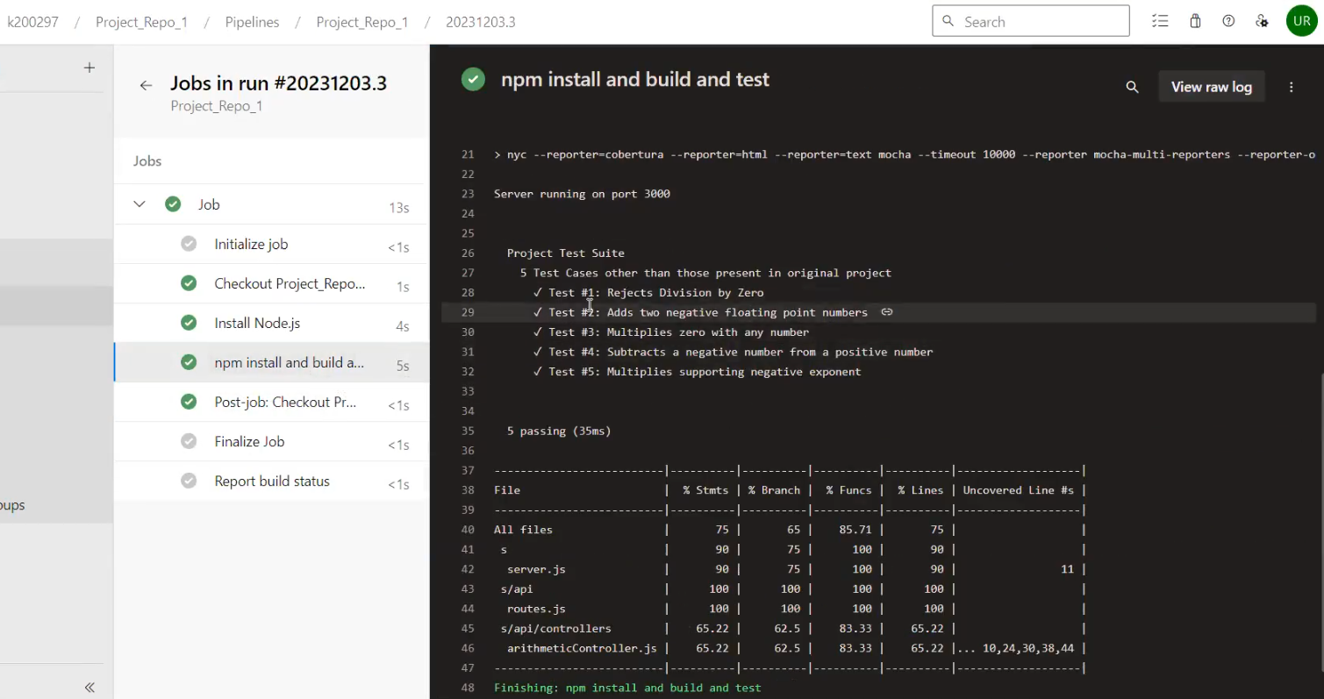

Slide 12
5. Continuous Deployment / Delivery (CD Pipeline - Release)
We created a release pipeline that performs the following:
Release Gates (Post-Deployment Gates)
Deployment Rings (Slow and Fast Production Rings)

Slide 13
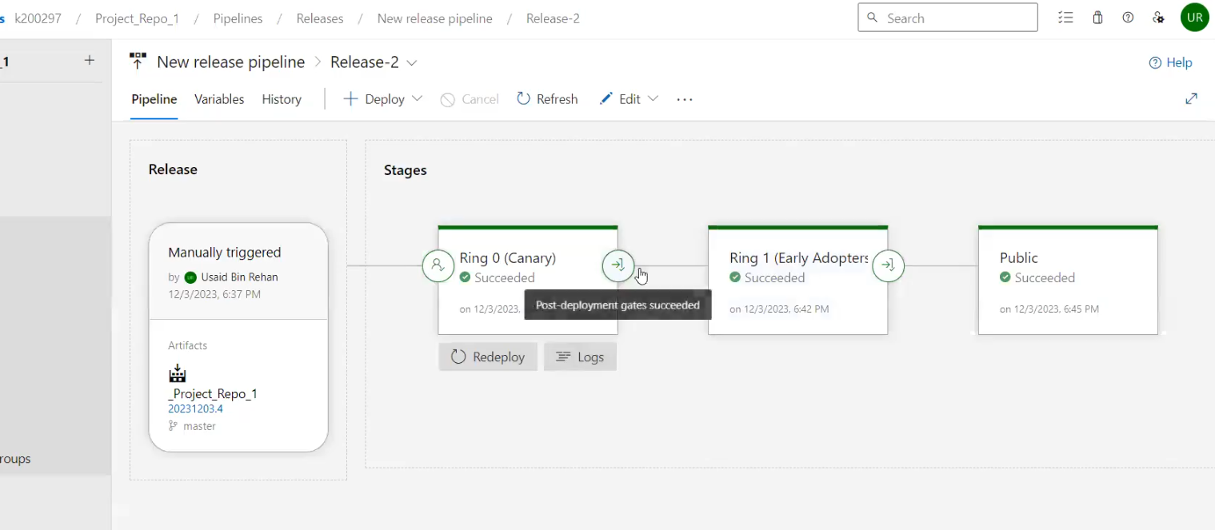

Slide 14
6. Integration with Dashboard
We integrated Build and Release Pipelines status widgets

Slide 15
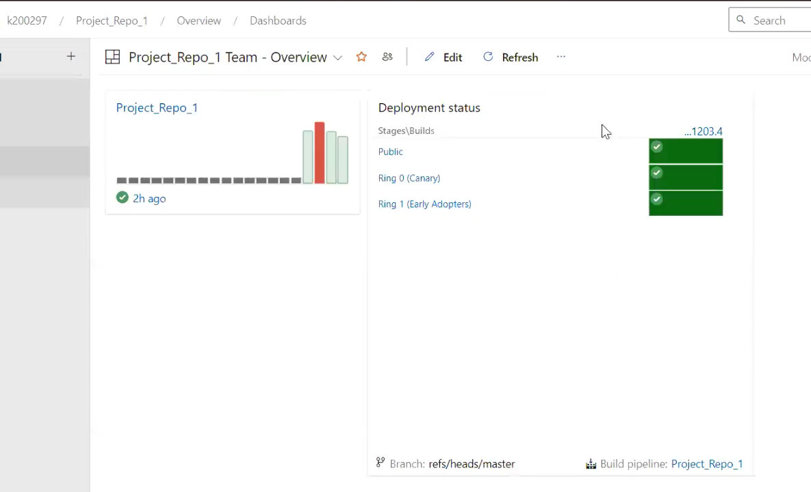

Slide 16
7. Integration with Slack
We integrated with Slack via service hooks and adding webhook URL for the alert notifications of pipelines

Slide 17
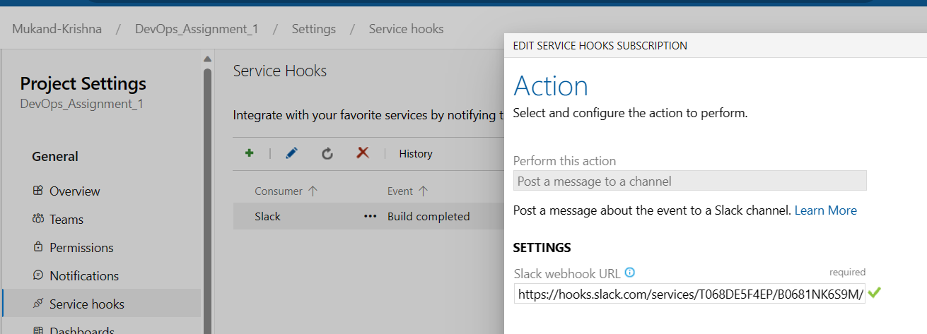

Slide 18
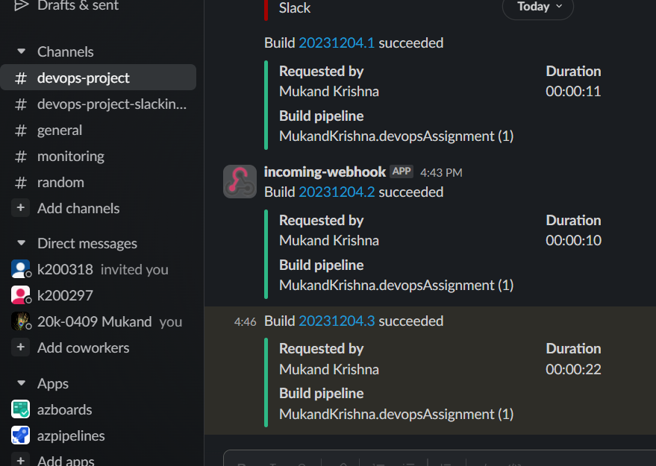
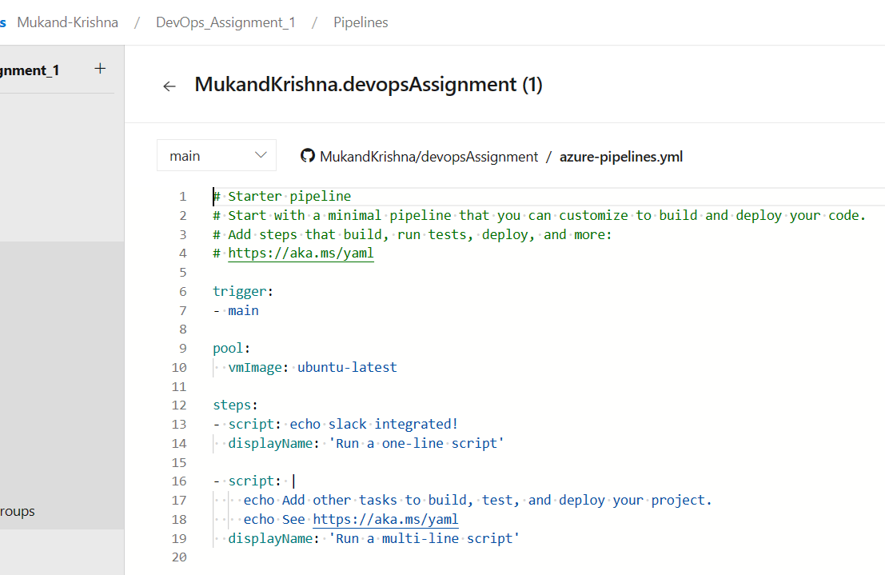

Slide 19
8. Containerization
We used Docker and Azure Registry for containerization

Slide 20
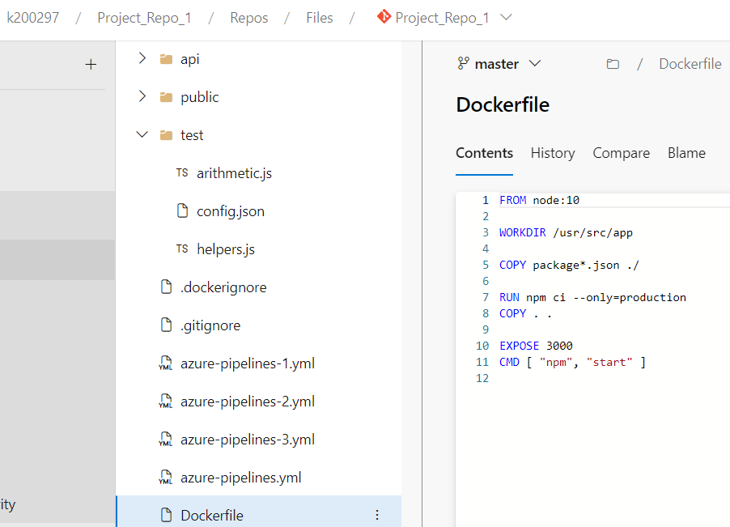

Slide 21
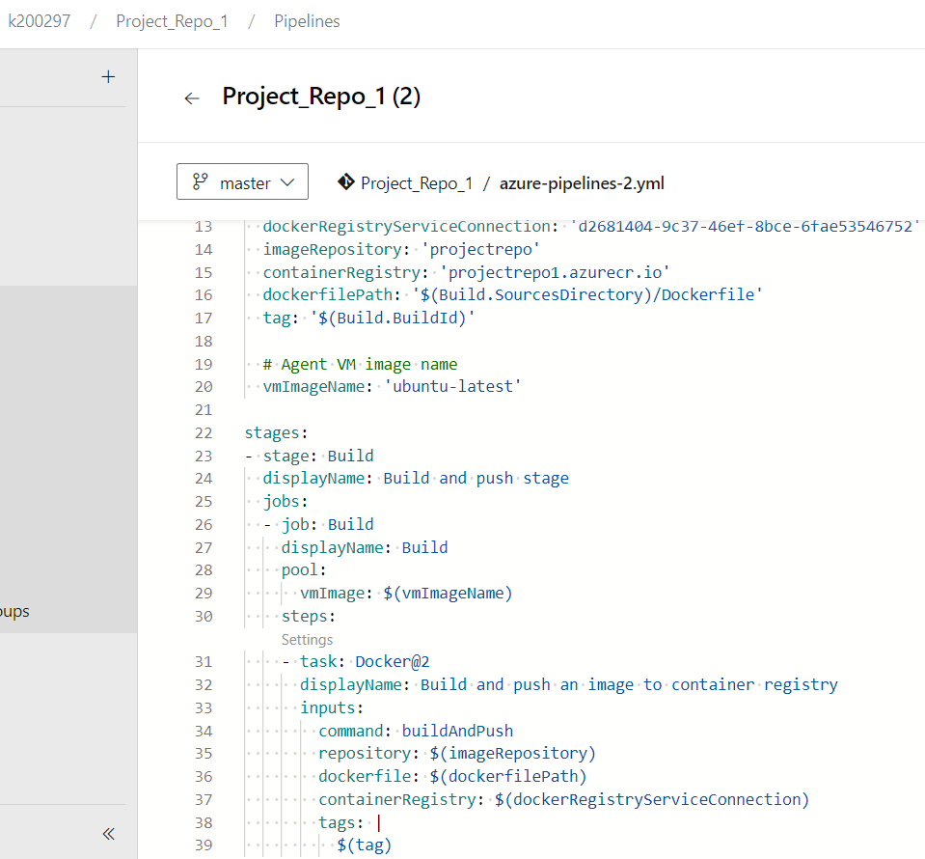

Slide 22
8. Wiki (Release Notes)
We added a Wiki of Release Notes for the latest release of the calculator app that contains our 5 test cases suite

Slide 23
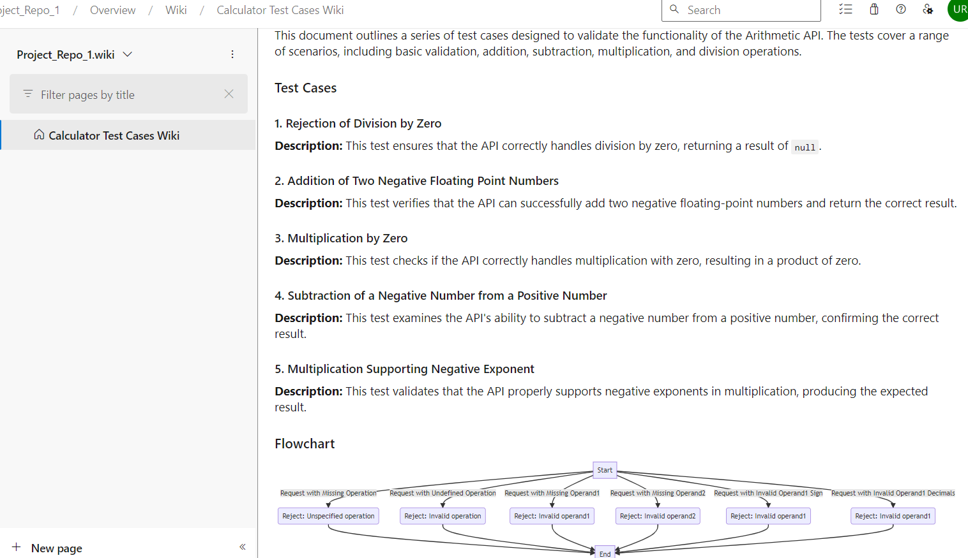

Slide 24
9. Azure Artifact
We added NPM Artifact for a ReactJs interface for the app

Slide 25
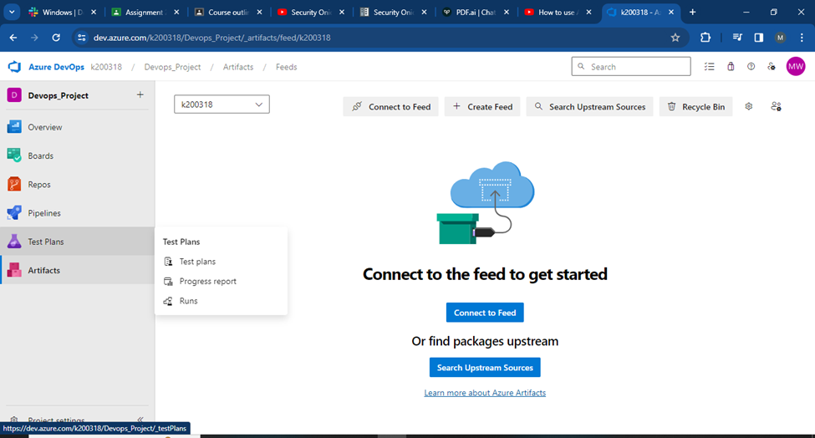
Continue. . .

Slide 26
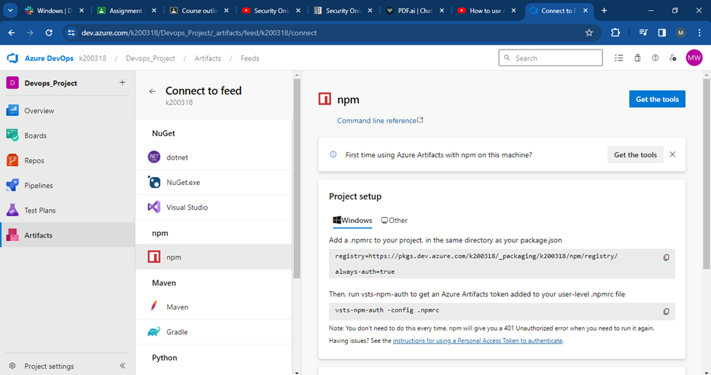
Continue. . .

Slide 27
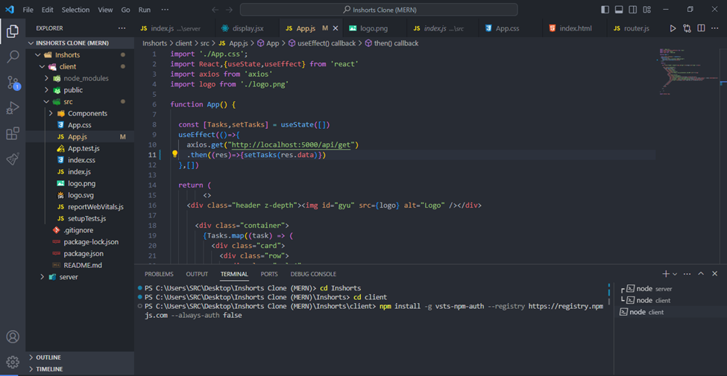
Continue. . .

Slide 28
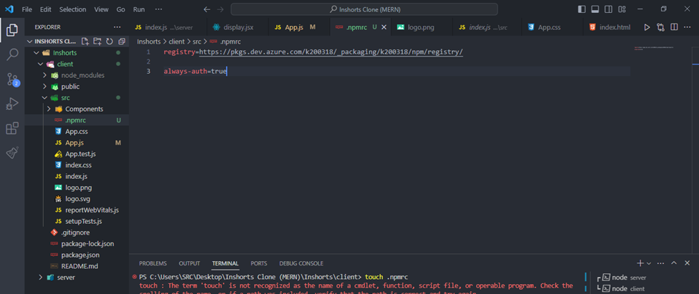
Continue. . .

Slide 29
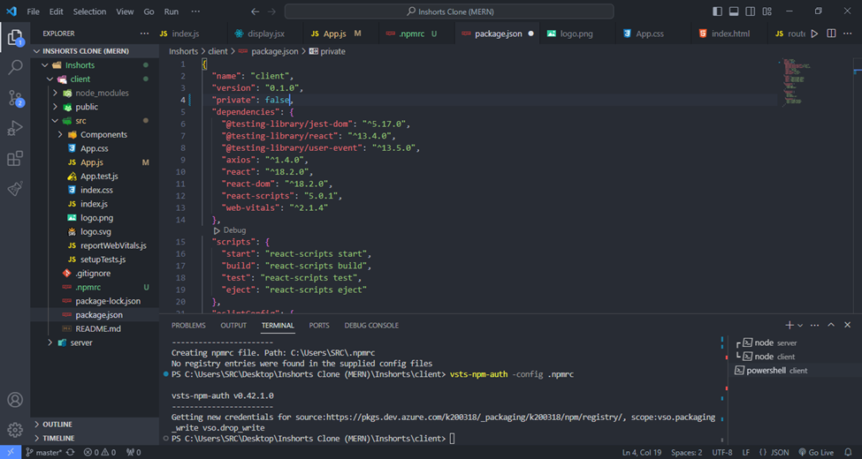
Continue. . .

Slide 30
Continue. . .

Slide 31
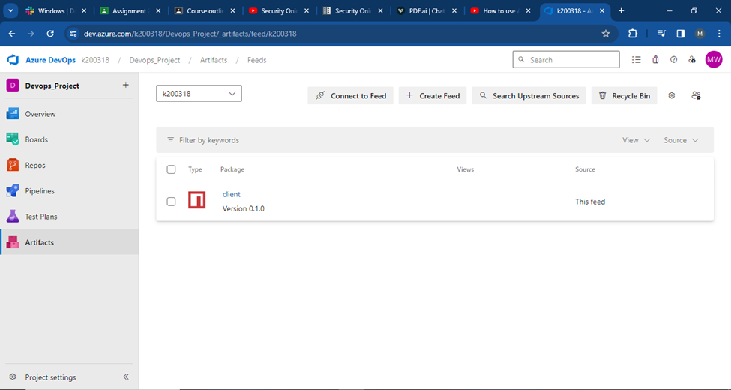
Continue. . .

Slide 32
10. Deleting the Resources
We deleted the Resource Group and viewed the costs incurred throughout the semester for all the reasonable time spent on activity labs and the project [Removed due to Sensitive Data]

Slide 33
Thank you for your time...

